Slide 1
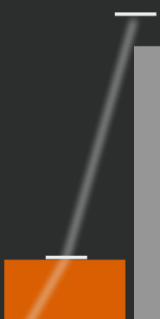
Small paths show the
dragging direction
and the bar’s valid heights

Slide 2
When a bar doesn’t change height, follow
the wave by repeatedly dragging up and down

Slide 3
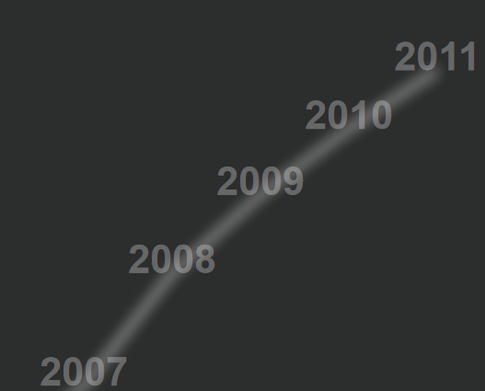
Click any year on the path
to go directly to that year

Slide 4

Bars with zero height
are still draggable
using the grey placeholder

Slide 6
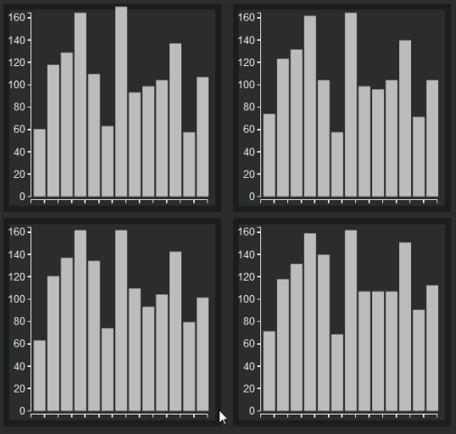
Views are arranged in time from left to right, then top to bottom
Time

Slide 7
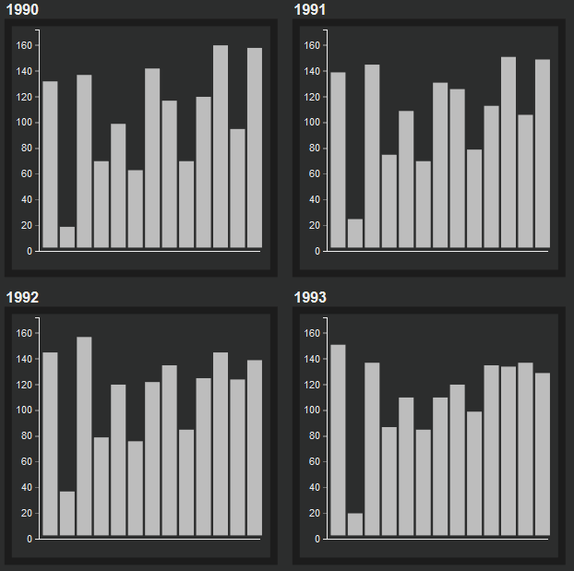
Views are arranged in time from left to right, then top to bottom
Time

